Slide 1

A Paranoid Administrator’s Guide to Windows Firewall
Garrett Clayton
@cyberscrying

Slide 2
About Me
6+ years in IT
System Administrator gone Security Analyst
Windows & Microsoft platforms have always been my home

Slide 3
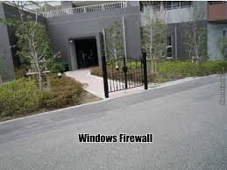
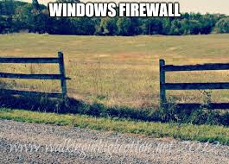
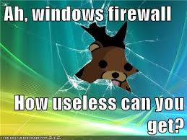
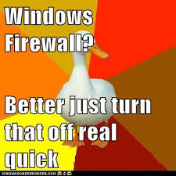
Why? Misconceptions About Windows Firewall
Cannot stop malware or advanced threats
Does not hinder attackers
Can be easily “bypassed”
Is difficult to design, implement, manage compared to internetwork device filtering
Turn it off!

Slide 4
The truth is more complex and directly impacts your security architecture

Slide 5
The Good: What Can Defenders Do?
Block/Filter inbound connectivity to our machines
Hamper lateral movement!
SMB (psexec abuse & pass-the-hash)
RDP
WMI/RPC/DCOM (remote process launch)
WSman (PowerShell Remoting)
Internetwork device that filters within layer 2?
Deny by default – Always
Block/Filter outbound connectivity
You can stop Microsoft’s own telemetry from working
We can deny by default and restrict connectivity to executable paths… so how paranoid are you?
Allow-by-default filtering is suboptimal for defending against Command & Control without application whitelisting!

Slide 6
The Good cont.
Prioritize blocking outbound connectivity from known living-off-the-land executables and scripts (LOLBAS) on your endpoints
wscript/cscript
PowerShell
cmd
Certutil
Explorer?
Prevent the attacker from establishing connections over legitimate binaries like scripting engines!
Of these methods, which do you choose in what scenario?
You need application whitelisting
What are the limitations when trying to prevent Command & Control?

Slide 7
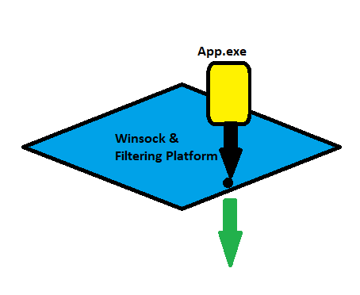
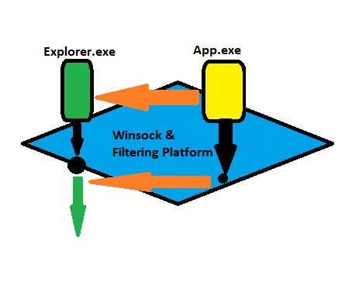
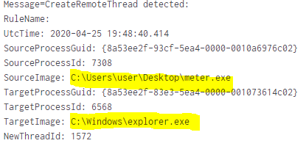
The Bad: Process Socket Migration
Allows evasion of Windows Firewall by injecting into legitimate processes
Tricky for defenders to detect
Original binary generates Sysmon Event ID 3. Does not reoccur on migration.
netstat –ano will show a Process ID that is no longer running
Process Monitor shows no TCP operations events after migration
Sysmon CreateRemoteThread (EventID 8) can detect.
Conclusion: you absolutely must block or detect the initial TCP handshake by executable.

Slide 8
Microsoft’s Recommendation: PAWs
The Tiered Administrative Model is an Active Directory architecture design
Tier 0 is the highest level of administration, should only be done from Privileged Access Workstations (PAWs)
Perfect candidates for least-privilege (ultra-paranoid mode) Windows Firewall configurations: Blocks on the SYN!
Good security architecture is putting your PAWs on a separate network which can administer systems over WMI/RDP/SMB/WSman via inbound rules
Your PAW should not talk to the internet**
** tHe cLoUd

Slide 9
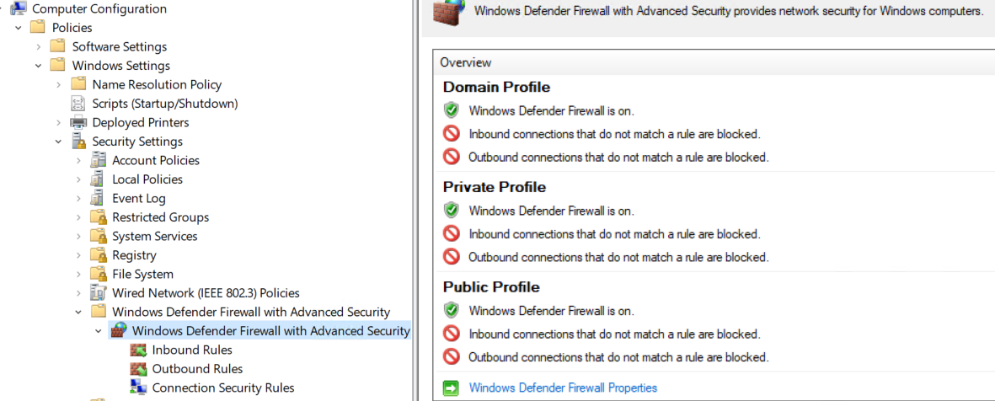
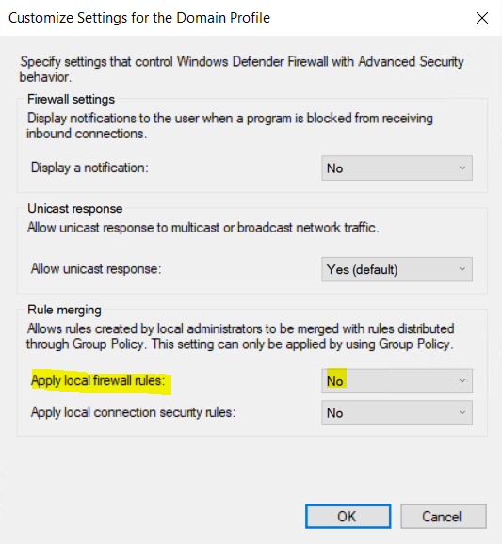
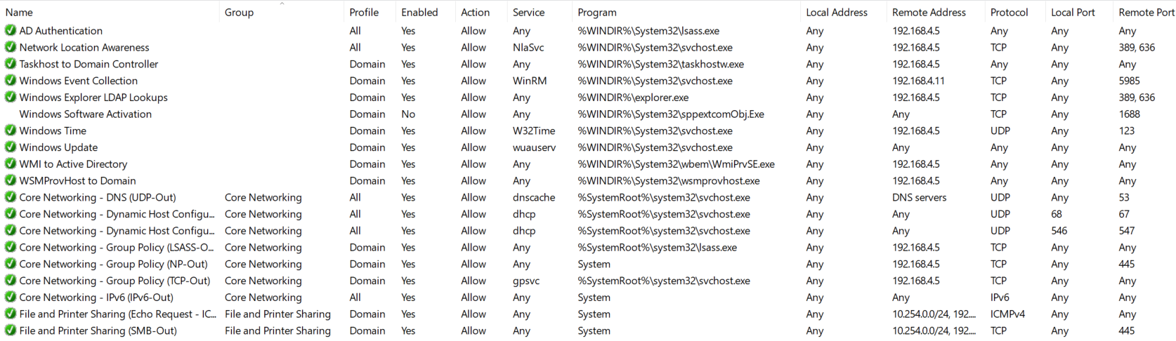

Slide 10
Assurance is accomplished by having draconian control over interactions between entities.
- Every dictator ever

Slide 11
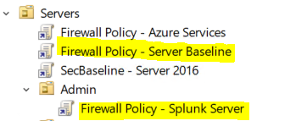
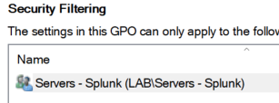
Layering Policies
Use OU’s & Security Groups to Customize Rules for Applications Running on Servers & sensitive systems!
There’s no excuse for not controlling what process can communicate where in our environment!
Time for the first demo: High Security Windows Firewall!

Slide 12
Tools We Will Use
Sysinternals Process Monitor
Filter “begins with” TCP & UDP
Immediate TCP Disconnects indicate Windows Firewall blockage
Netstat or Get-NetTCPConnection / Get-NetUDPConnection
Windows Firewall log file: %WINDIR%\system32\logfiles\firewall\pfirewall.log
PSexec to test lateral movement using SMB

Slide 13
Garrett you are f***ing crazy
Ok, ok so that sounds hard, but what if we just want a quick win?
Block the LOLBAS! https://lolbas-project.github.io
Thanks to Oddvar Moe @oddvarmoe for hosting this repo!
You should already have application whitelisting & privileged access management (Shameless plug for https://beyondtrust.com products)
COMBINED
Kills command & control as well as initial exploitation using macros, scripts, etc.
Can prevent meterpreter from residing in low-privileged legitimate processes (explorer.exe)

Slide 14
Second Demo – LOLBAS Firewall Blocks
Easily stop payload delivery and some Command & Control over common binaries:
rundll
wscript/script
PowerShell
Evasion with Meterpreter process migration
Prevent lateral movement:
PSexec
WMI remote process launch
WSMan

Slide 15
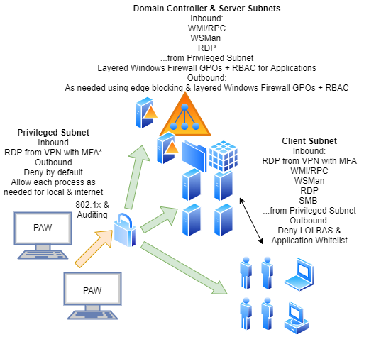
A Defensible Security Architecture With Windows Firewall

Slide 16
References & Further Reading
https://channel9.msdn.com/Events/Ignite/New-Zealand-2016/M377
https://medium.com/@cryps1s/endpoint-isolation-with-the-windows-firewall-462a795f4cfb
https://docs.microsoft.com/en-us/windows-server/identity/securing-privileged-access/privileged-access-workstations
https://www.beyondtrust.com/resources/webcasts/how-to-hack-and-then-defend-the-endpoint-1
Special thanks to…
Jessica Payne @jepayneMSFT
Oddvar Moe @Oddvarmoe
Paula Januszkiewicz @PaulaCqure

